Slide 1
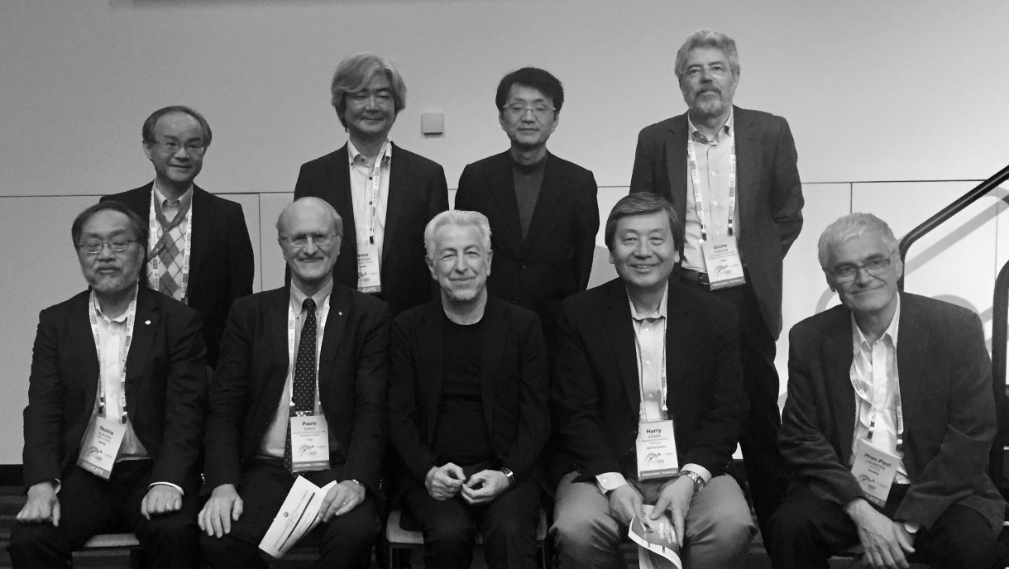
ICRA 2018 Workshop on "Grand Scientific Challenges for the Robot Companion of the Future”, May 21, 2018
Yasuo Kuniyoshi
University of Tokyo, Japan
Yukihiko Nakamura
University of Tokyo, Japan
Giulio Sandini
IIT and University of Genova, Italy
Atsuo Takanishi
Waseda University
Japan
Jean-Paul Laumond
CNR-LAAS, France
Toshio Fukuda
Nagoya University
Japan
Harry Asada,
MIT, USA
Paolo Dario
Scuola Superiore Sant’Anna, Pisa, Italy
Oussama Khatib,
Stanford University, USA

